Slide 1

Youth Drop in Sports
Palmerston and regional basketball association

Slide 2




Youth Drop In Sport (YDIS)
Our Partners ;Territory Families, The Department of the Chief Minister, City of Palmerston and Larrakia Nation
Palmerston is 22km from Darwin City
Population 37000

Slide 3
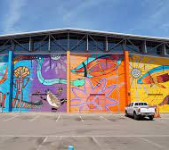
Local challenges
Community concerns regarding youth crime
YDIS was designed to service the youth of Palmerston
Targeted demographic ; at risk youth aged 12-18 years
Especially those in recent contact with the juvenile justice system.

Slide 4
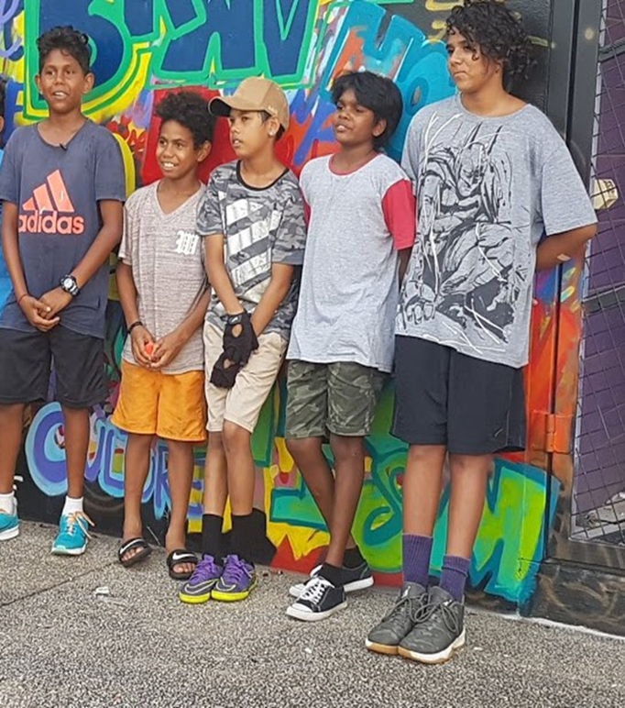
Implementation
We set out to remove the barriers to participation;
Transport
Food Security
No Uniforms
Free programs
Access to a communal phone and chargers

Slide 5
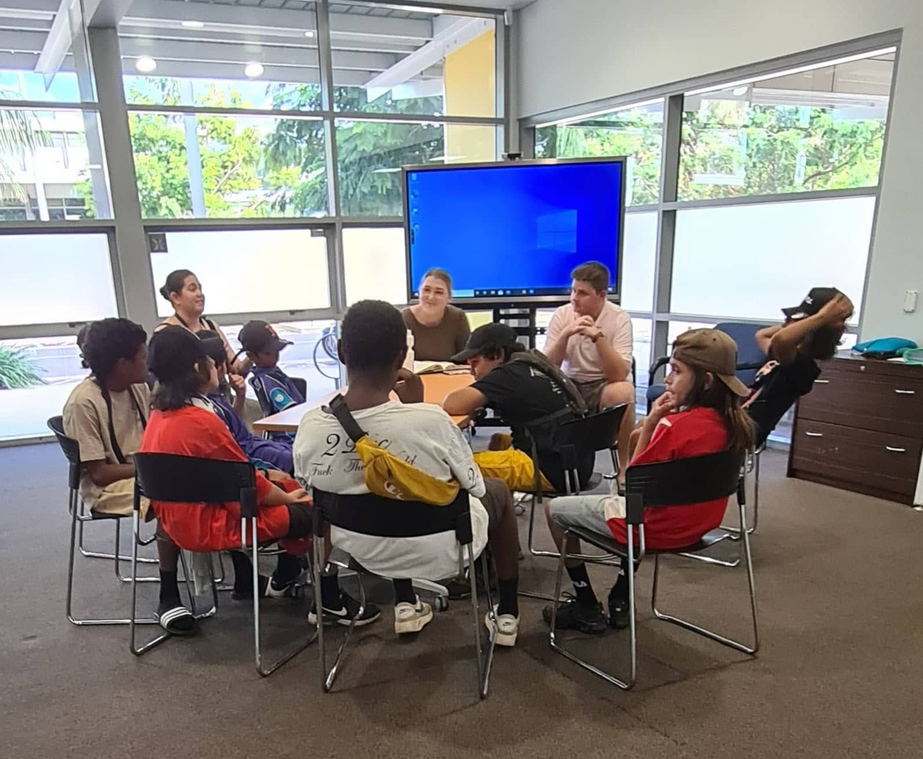
Approach
Youth Advisory panels essential to continual improvement
Engagement of short-term activity providers
Continual collaboration between funders, services and activity providers

Slide 6
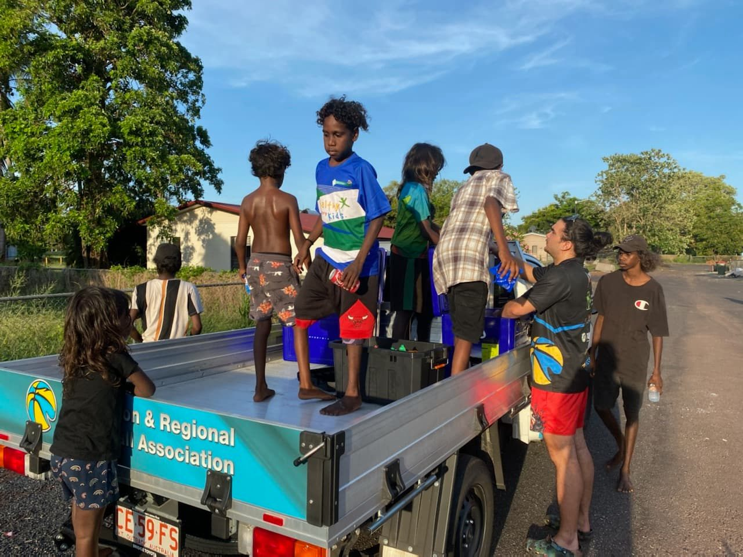
Consistent staffing
Data capture and analysis
Reflection and revision
Celebrating the wins!

Slide 7
Impact
Participation data
July 2022 - May 2023
Total number of participants - 17,470
Age range of participants - 4 to 18 years
Estimated % of ASTI participants - 75%
Increased participation in organised sport
Increased access to service providers such as Territory Families Youth Engagement Officers for young people
Early intervention for at risk youth and referral on to service providers
Community Work order placements allowing young people to be visible in the community “doing the right thing”

Slide 8
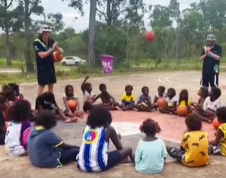
Personal impacts
Sense of belonging to community
Strengthening social networks
“Circuit Breaker”
Safety and connection

Slide 9

From the Young People themselves…
What do you like about coming to Youth Drop-In Sports?
“I come here to play.”
What do you play?
“I play basketball.”
What’s the best thing about coming here?
“Play.”
Play? You just like playing?
“Yeah.”
“Um… the food, the snacks.
That, I like to come here with my friends when I’m bored at home.
I, um, play basketball games with my friends, and I play volleyballs.”
“I like that lots of kids come here. It’s safe.
And it’s fun for all ages.”
And what do you do when you come here?
“Probably sit down and play video games with my friends. Or I just shoot some hoops.”
“I love the people here, and I love the centre.
Like, I love playing basketball. And just love dropping in and meeting new friends, and yeah.”
What would be your favourite activity?
“Um, I always like doing, um, anything, long as I do it with other people.”

