Slide 1

Play, Participation, & Poverty
Dr. Alexander W. O’Donnell
National Children’s Week
Anti-Poverty Week
23rd October, 2023

Slide 2
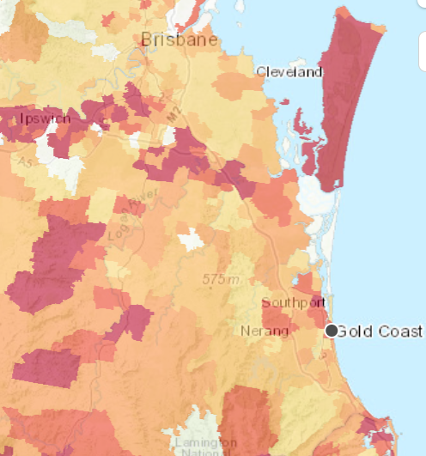
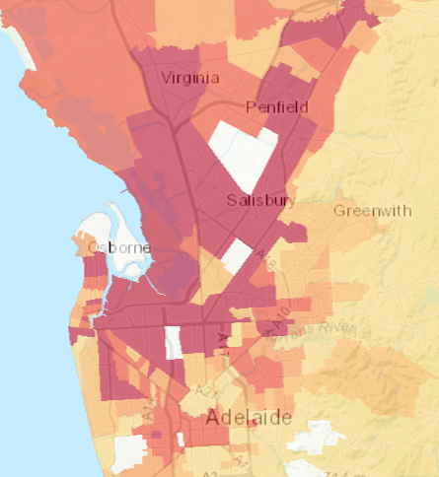
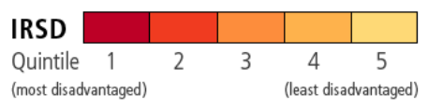

Slide 3
Adequacy of Guaranteed Minimum Income benefits Relative to Median Income
Source: OECD, https://stats.oecd.org/Index.aspx?DataSetCode=IA#

Slide 4

Socioeconomic health inequities are neither inevitable nor predestined.

Slide 5
Socioeconomic Status
Income
Poverty
Region
Food
Community Cohesion
Social Relationships
Growth Opportunities
Cultural Capital
Health Services
Physical Health
Mental Health
Mortality
Academic Attainment

Slide 6




EXTRAFAMILIAL RELATIONS
DEVELOPING AGENCY
POSITIVE PEER RELATIONS
PERSONAL GROWTH

Slide 7
“The compensation hypothesis”
The developmental assets in activities will be especially salient when youth have fewer assets elsewhere.
More vulnerable youth will see greater benefits from participation, relative to more advantaged youth.
More socioeconomically advantaged youth will do, on average, better regardless of their participation.

Slide 8
Socioemotional Symptoms amongst Resettled Refugees
Source: O’Donnell et al. 2020, Building New Life in Australia

Slide 9
INTENSITY
Time spent in activities
BREADTH
Total number of different activities
DURATION
Enduring participation in activities over time
CONTINUATION
Enduring participation in the same activity over time

Slide 10
ATAR after School by Activity Participation in Grade 8
BREADTH
Total number of different activities
Source: O’Donnell et al. 2022, Longitudinal Study of Australian Children

Slide 11

ATAR after School by Activity Participation in Grade 8
210 Degree Pathways
185 Degree Pathways
154 Degree Pathways
Source: O’Donnell et al. 2022, Longitudinal Study of Australian Children

Slide 12
Externalising Behaviours from Grade 8 to 9
CONTINUATION
Enduring participation in the same activity over time
Source: O’Donnell & Barber, 2020, Youth Activity Participation Study

Slide 13

So, what can we do?

Slide 14
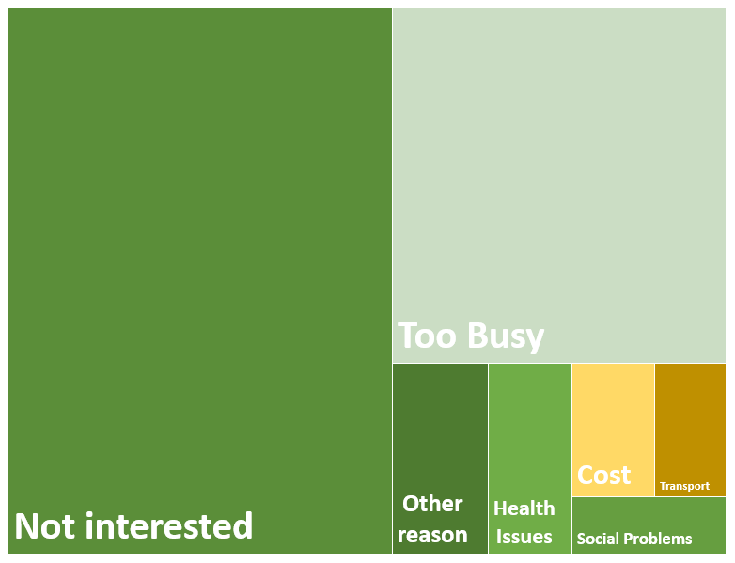
Source: Unpublished Finding, Longitudinal Study of Australian Children

Slide 15









Families
Schools/Communities
Social Policy
Cost of Participation
Exclusionary policies
Grounds/Spaces are Required
Transportation
Activities made Undesirable
Too Much Emphasis on Sports
Work Restraints
Too Much Self Interest
One-Off or Focused Grants

Slide 16
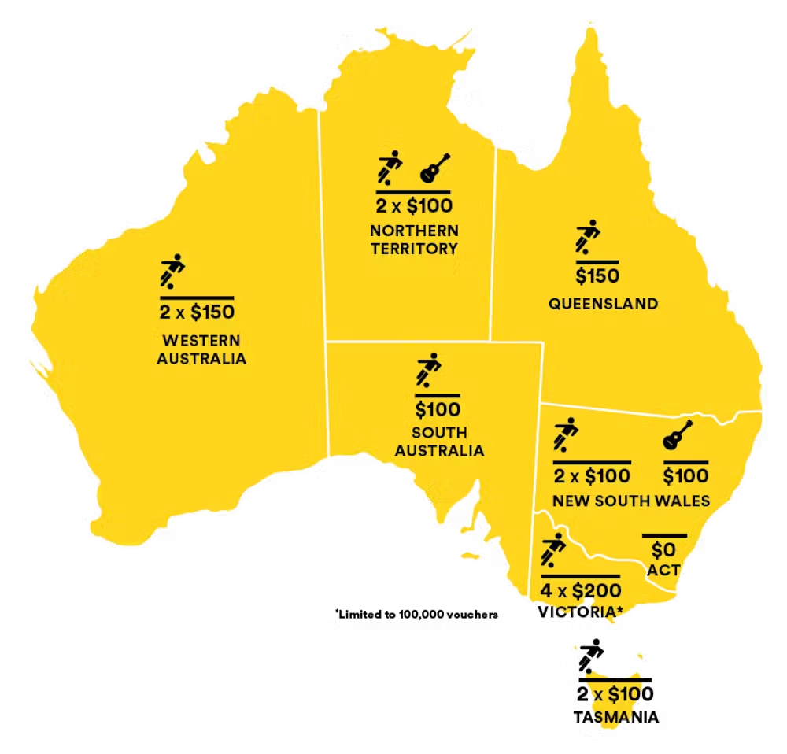
Valid as of Dec, 2021

Slide 17
Carpooling
Cross-organisation scheduling at shared facilities
Families
Schools/Communities
Social Policy
Build multipurpose facilities
Long-term funding focused on retention
Make all activities free

