Slide 1
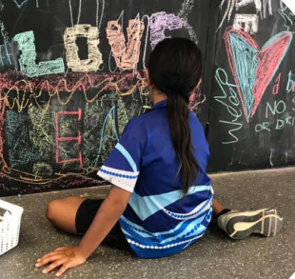
“Good people showing them the proper way”
Palmerston Youth Activity Grant
Funding Evaluation
Department of Territory Families Housing and Communities
Sally Weir Darwin and Palmerston Youth Program Coordinator
Rachel Fosdick Palmerston and Regional Basketball Association

Slide 2
Palmerston Youth Activity Grant
Aims:
To support delivery of after hours and school holiday activities.
To ensure 10-17 year olds particularly those at risk have accessible, safe and fun activities.
To ensure young people are consulted about activities provided.
To link young people with support.
Strengthen collaborative working relationships with key stakeholders and improve coordination across the youth and related sectors.
Department of Territory Families Housing and Communities

Slide 3
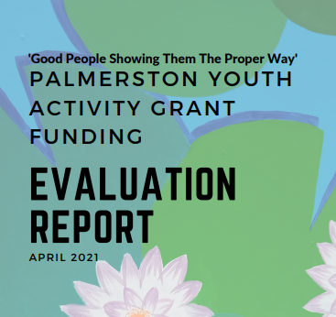
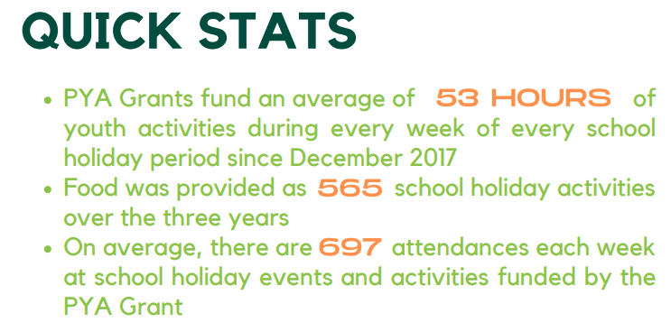
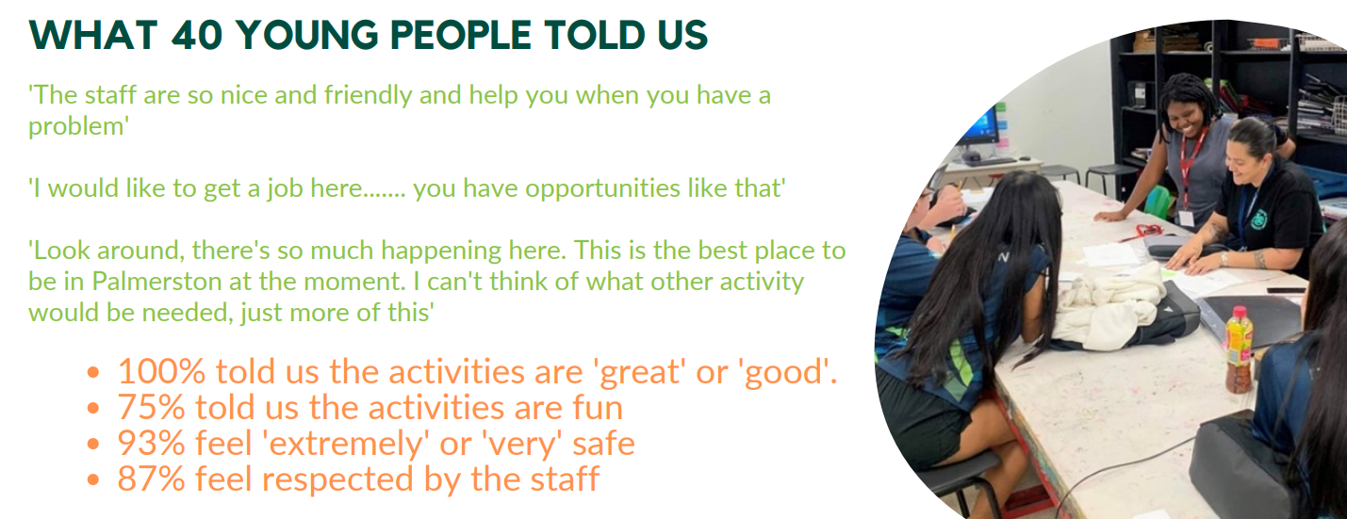
Palmerston Youth Activity Grant Funding Evaluation Report
(April 2021 Gretchen Ennis Useful Projects)

Slide 4
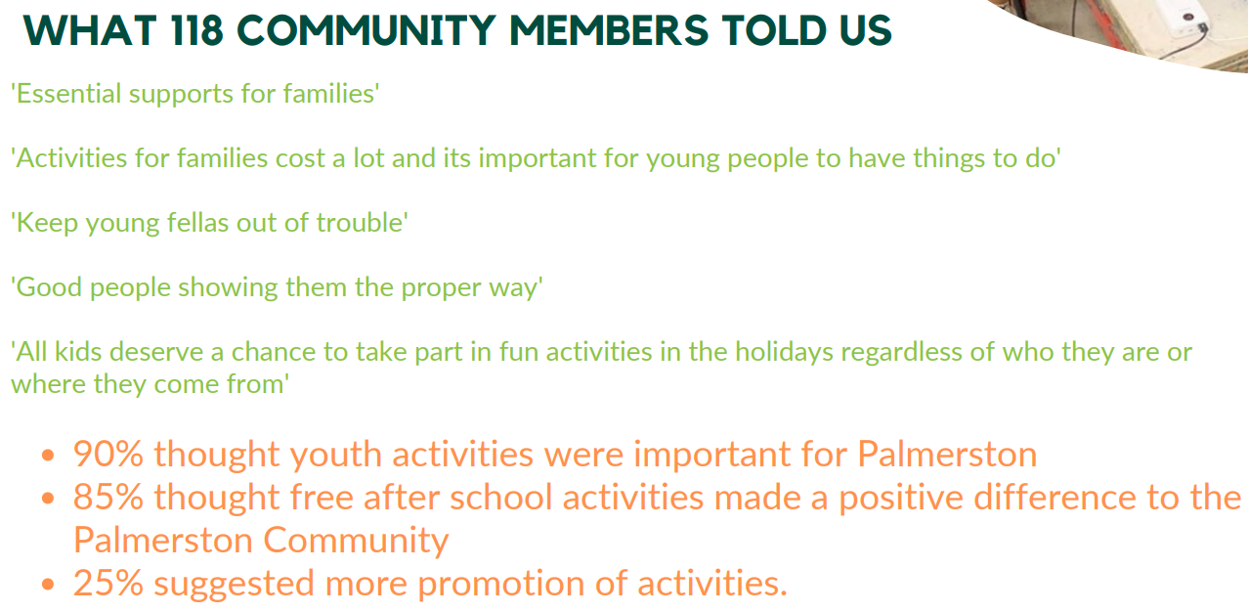
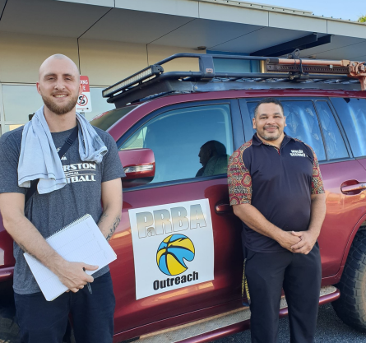

Slide 5

